Slide 1
Discrete Mathematics
Chapter 5
Section 5.1
The Basics of Counting Principles

Slide 2
Basic Counting Principles
Two basic counting principles:
Product rule
Sum rule
Product Rule: Suppose that a procedure can be broken down into a sequence of two tasks. If there are n₁ ways to do the first task and for each of these ways of doing the first
task, there are n₂ ways to do the second task, then there are n₁n₂ ways to do the procedure.

Slide 3
Examples
A new company with just two employees, Sanchez and Patel, rents a floor of a building with 12 offices. How many ways are there to assign different offices to these two employees?
Solution: Sanchez can be assigned in 12 ways and then Patel can be assigned in 11 ways. By the product rule, there are 12 · 11 = 132 ways to assign offices to these two employees.

Slide 4
Examples
How many functions are there from a set with m elements to a set with n elements?
Solution: A function corresponds to a choice of one of the n elements in the codomain for each of the m elements in the domain.
Hence, by the product rule there are n . n . . . . . n = n^{m} functions from a set with m elements to one with n elements.

Slide 5
Examples
How many one-to-one functions are there from a set with m elements to one with n elements?
Solution: First note when m > n there are no one-to-one functions from a set with m elements to a set with n elements. Now let m ≤ n. Suppose the elements in the domain are a₁, a₂, ... , a_{m}. There are n ways to choose the value of the function at a₁. Because the function is one-to-one, the value of the function at a₂ can be picked in n - 1 ways.
In general, the value a_{k} can be chosen in n -k + 1 ways. By the product rule, there are n(n - 1 )(n - 2) … (n - m + 1 )

Slide 6
Basic Counting Principles
Sum Rule: If a task can be done either in one of n₁ ways or in one of n₂ ways, where none of the set of n₁ ways is the same as any of the set of n₂ ways, then there are n₁ + n₂
ways to do the task.
A student can choose a computer project from one of three lists. The three lists contain 23, 15, and 19 possible projects, respectively. No project is on more than one list. How many possible projects are there to choose from?
By the sum rule, there are 23 + 15 + 19 = 57 ways to choose projects.

Slide 7
Inclusion-Exclusion Principle
Suppose that a task can be done in n₁ or in n₂ ways, but that some of the set of n₁ ways to do the task are the same as some of the n₂ other ways to do the task.
To correctly count the number of ways to do the two tasks,
we add
the number of ways to do it in one way
the number of ways to do it in the other way,
and then subtract
the number of ways to do the task in a way that is both among the set of n₁ ways and the set of n₂ ways.
This technique is called the principle of inclusion-exclusion.

Slide 8
Example
How many bit strings of length eight either start with a 1 bit or end with the two bits 00?
Solution: We can construct a bit string of length eight that begins with a 1 in 2⁷ = 128 ways.
Similarly, we can construct a bit string of length eight ending with the two bits 00, in 2⁶ = 64 ways.
Some of the ways to construct a bit string of length eight starting with a 1 are the same as the ways to construct a bit string of length eight that ends with the two bits 00. There are 2⁵ = 32 ways to construct such a string.
Therefore, total number of ways 128 + 64 – 32 = 160.

Slide 9
Discrete Mathematics
Chapter 5
Section 5.2
The Pigeonhole Principle

Slide 10
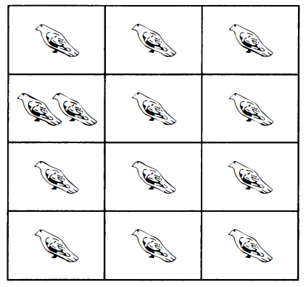
The Pigeonhole Principle
If k is a positive integer and k + 1 or more objects are placed into k boxes, then there is at least one box containing two or more of the objects.

Slide 11
Corollary 1
A function f from a set with k + 1 or more elements to a set with k elements is not one-to-one.
Proof: Suppose that for each element y in the codomain of f we have a box that contains all elements x of the domain of f such that f(x) = y.
Because the domain contains k + 1 or more elements and the codomain contains only k elements, the pigeonhole principle tells us that one of these boxes contains two or more elements x of the domain.
This means that f cannot be one-to-one.

Slide 12
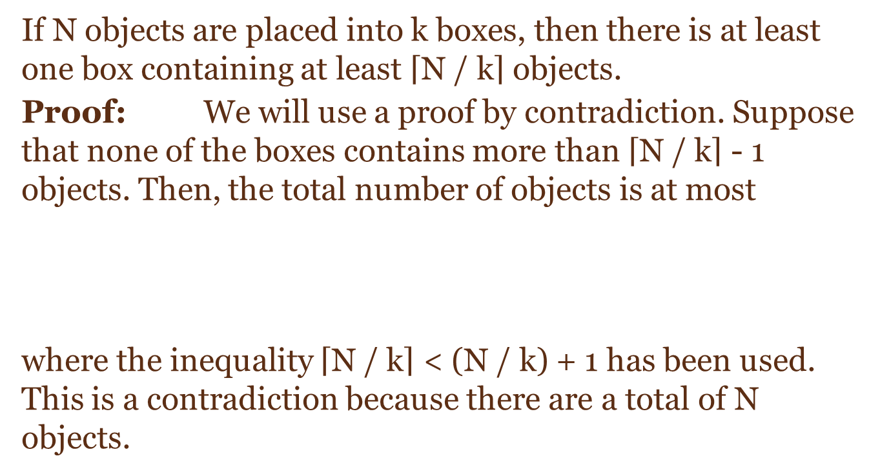
The Generalized Pigeonhole Principle
If N objects are placed into k boxes, then there is at least one box containing at least $\left\lceil \text{N}\text{ / }\text{k}\right\rceil$ objects.
Proof: We will use a proof by contradiction. Suppose that none of the boxes contains more than $\left\lceil \text{N}\text{ / }\text{k}\right\rceil$ - 1 objects. Then, the total number of objects is at most
where the inequality $\left\lceil \text{N}\text{ / }\text{k}\right\rceil$ < (N / k) + 1 has been used. This is a contradiction because there are a total of N objects.

Slide 13
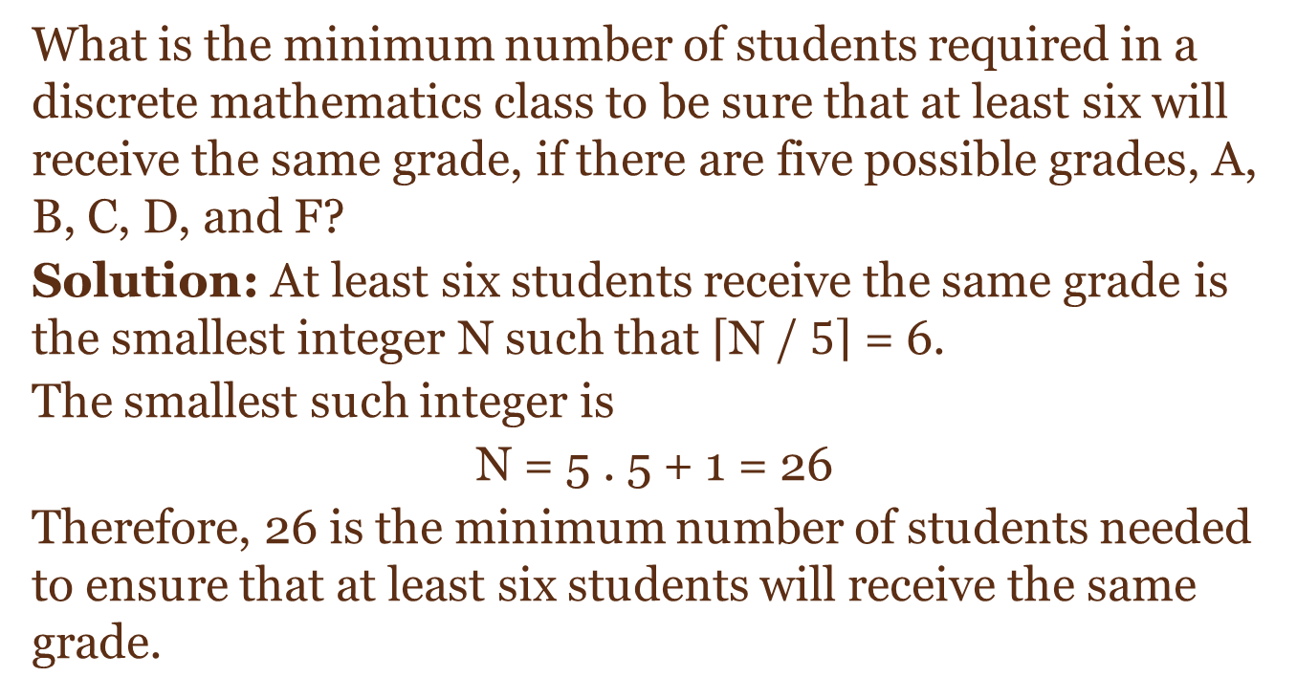
Example
What is the minimum number of students required in a discrete mathematics class to be sure that at least six will receive the same grade, if there are five possible grades, A, B, C, D, and F?
Solution: At least six students receive the same grade is the smallest integer N such that $\left\lceil \text{N}\text{ / }5\right\rceil$ = 6.
The smallest such integer is
N = 5 . 5 + 1 = 26
Therefore, 26 is the minimum number of students needed to ensure that at least six students will receive the same grade.

Slide 14
Discrete Mathematics
Chapter 5
Section 5.3
Permutation and Combination

Slide 15
Permutation
In how many ways can we select three students from a group of five students to stand in line for a picture? In how many ways can we arrange all five of these students in a line for a picture?
Solution: By the product rule, there are 5 . 4 . 3 = 60 ways to select three students from a group of five students to stand in line for a picture.
To arrange five students, there are 5 · 4 · 3 · 2 · 1 = 1 20 ways to arrange all five students in a line for a picture.

Slide 16
Permutation
How many permutations of the letters ABCDEFGH contain the string ABC?
Solution: Because the letters ABC must occur as a block, we can find the answer by finding the number of permutations of six objects, namely, the block ABC and the individual letters D , E , F , G, and H. Because these six objects can occur in any order, there are 6 ! = 720 permutations of the letters ABCDEFGH in which ABC occurs as a block.

Slide 17
Exercise
How many permutations of the letters ABCDEFGH contain
the strings BA and FGH?
the strings AB, DE, and GH?
A group contains n men and n women. How many ways are there to arrange these people in a row if the men and women alternate?

Slide 18
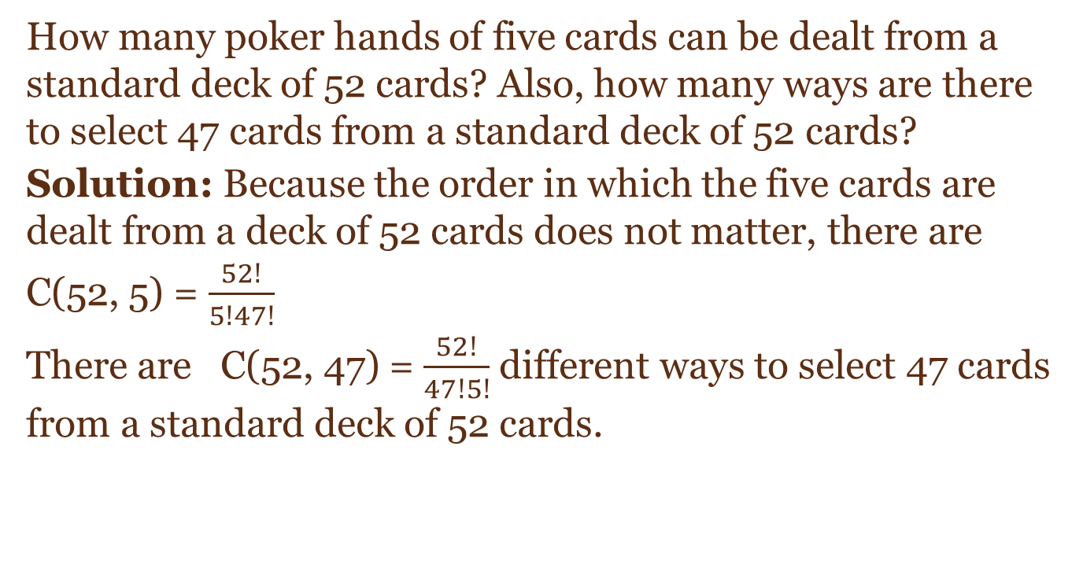
Combination
How many poker hands of five cards can be dealt from a standard deck of 52 cards? Also, how many ways are there to select 47 cards from a standard deck of 52 cards?
Solution: Because the order in which the five cards are dealt from a deck of 52 cards does not matter, there are
C(52, 5) = $\frac{52!}{5!47!}$
There are C(52, 47) = $\frac{52!}{47!5!}$ different ways to select 47 cards from a standard deck of 52 cards.

Slide 19
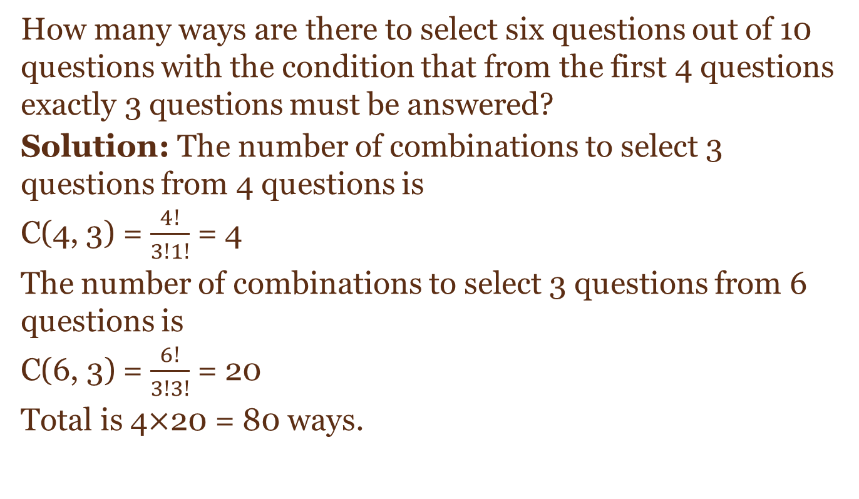
Combination
How many ways are there to select six questions out of 10 questions with the condition that from the first 4 questions exactly 3 questions must be answered?
Solution: The number of combinations to select 3 questions from 4 questions is
C(4, 3) = $\frac{4!}{3!1!}$ = 4
The number of combinations to select 3 questions from 6 questions is
C(6, 3) = $\frac{6!}{3!3!}$ = 20
Total is 4$×$20 = 80 ways.

Slide 20
Exercise
How many bit strings of length 10 have
exactly three 0’s?
more 0’s than 1’s?

